Slide 1


Look into the future ….
MT880-Meter, that meets your needs through high functionality and communication flexibility
Waleed Abd El-Hameed, MScEE
Product Technical Support manager
Waleed.hammed@iskraemeco.com.eg

Slide 2
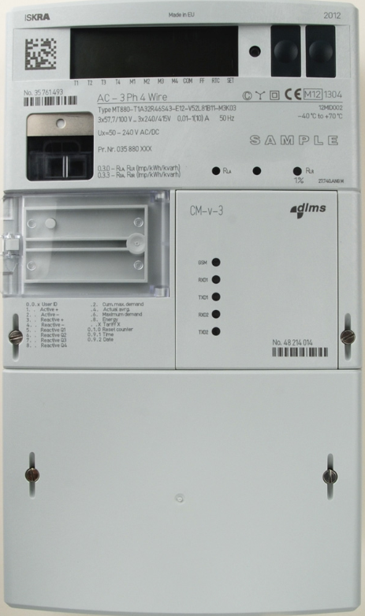
Meter parts #1
LCD
Up / down scroll button
Meter SN.
IR optical interface (no power reading)
Two LEDs Active & Reactive
Billing reset button / CT & VT label
Communication module
Sealing meter cover screw
terminal cover screw
Terminal cover
Meter Antenna

Slide 3
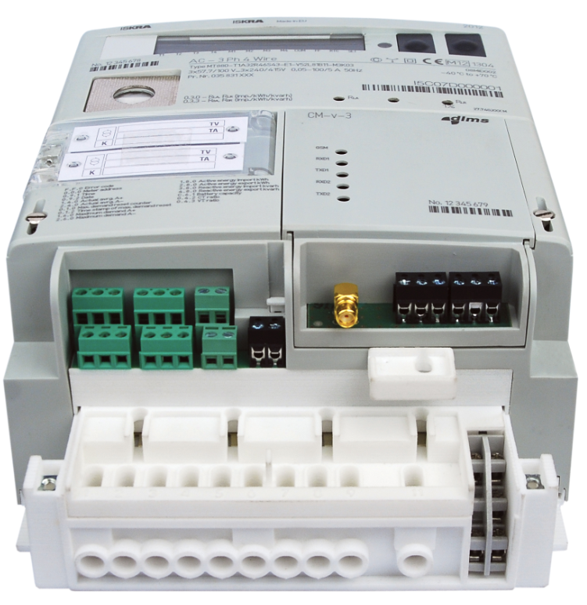
Meter parts #2
Modem & communication status
Terminal cover opening sensor
Antenna connector
Mechanism for CM module install / de-install
Inputs / outputs part
Additional terminals (external supply, communication interface)
Additional voltage terminals
Meter terminals

Slide 4
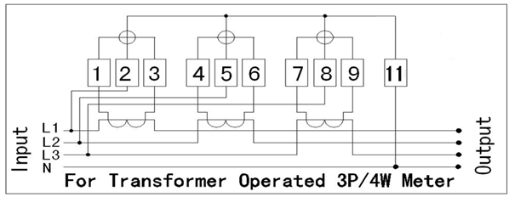
Wiring Diagram
Phase | Terminals
 | Current input | Current output | Voltage input
L1 | 1 | 3 | 2
L2 | 4 | 6 | 5
L3 | 7 | 9 | 8
N | 10 | 12 | -

Slide 5


Wiring Diagram in series
Old meter
new meter
1
2
3
4
5
6
7
8
9
N
1
2
3
4
5
6
7
8
9
N

Slide 6
Correct wiring connection
Stranded cables can be used with appropriate ferrules only

Slide 7
SIM Card installation
1- pull (step 1) the releasing mechanism till the final position (step 2).
2- Module will move up for a few millimeters and it can be easily removed (step 3).

Slide 8
SIM Card installation
1. SIM card holder is placed on the bottom side of communication module.
2. To insert the card, move SIM card locking mechanism down,
3. open holder and
4. gently insert the card.
5. Close it and lock mechanism pushing it up.

Slide 9
SIM Card installation
1. move locking mechanism to the “middle” position, where arrows are aligned in the line (step 1),
2. carefully insert the module (step 2),
3. gently press the module down and move locking mechanism into the “locked” position (step 3).

Slide 10
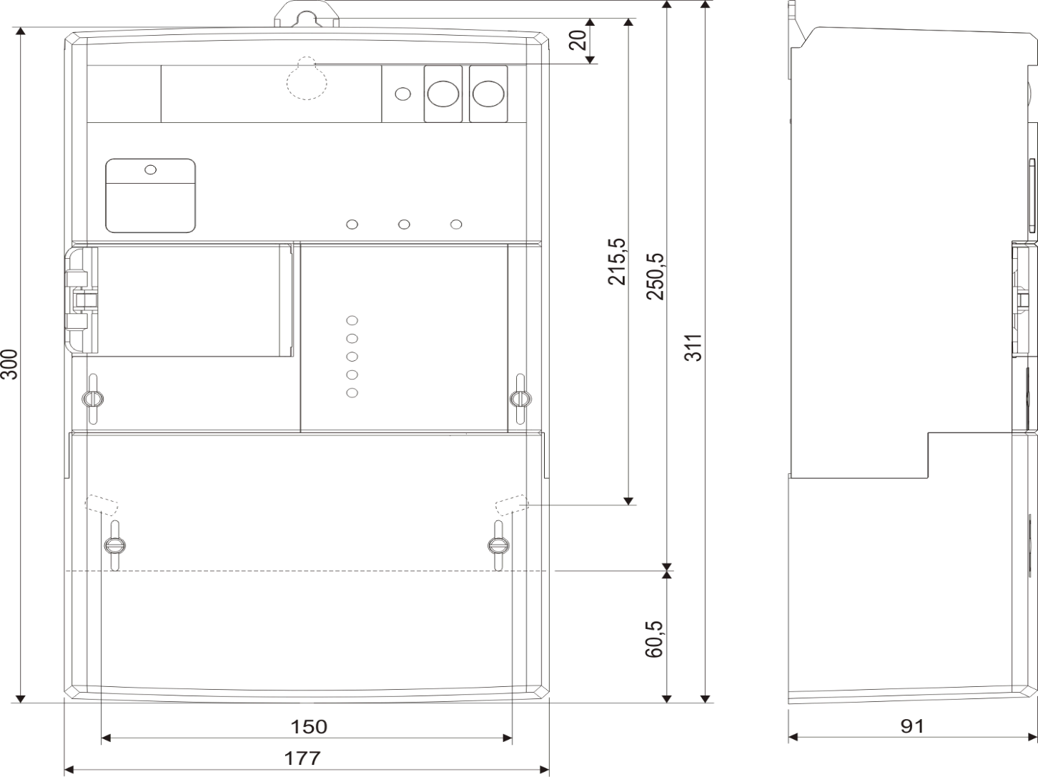
Meter Dimension

Slide 11
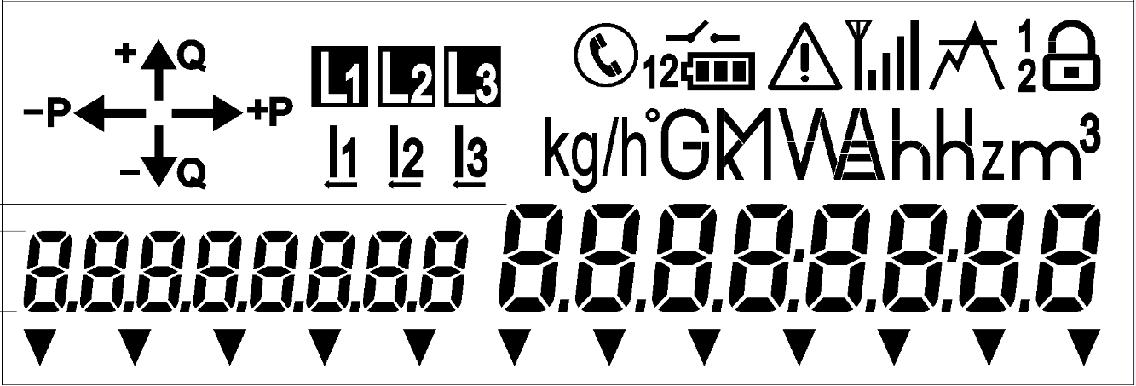
Meter parts - LCD
Voltage & current presence (direction)
Register units, different statuses
Information quadrant
OBIS code
Cursors
Register value

Slide 12

Correct installation procedure
Actual connection state on the LCD
Phase quadrants
Voltage presence and rotation field
Current presence and direction
Load control state, battery state, 5A relay state, alarm presence
Please fill the checklist
Photo After installation

Slide 13
